Slide 1
The AI Revolution: A New Dawn
Created and Presented by
Huzaifa Iqbal

Slide 2
Table of content
Introduction to AI
History of AI
Types of AI
Benefits of AI
Risks of AI
Conclusion

Slide 3
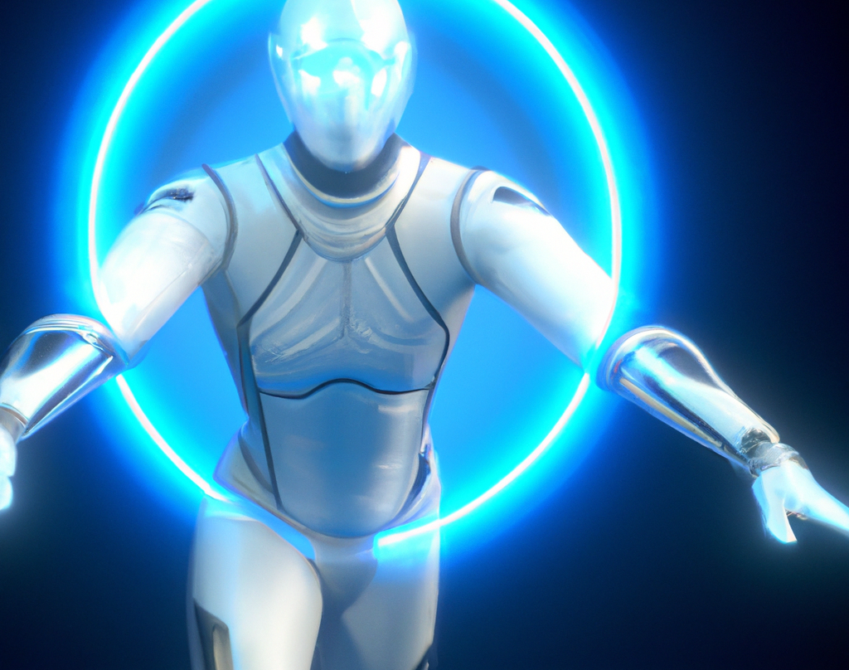
Introduction to AI
Artificial Intelligence (AI) is the ability of machines to perform tasks that normally require human intelligence. AI has become increasingly important in our lives, from helping us make decisions to powering our everyday devices.
AI is helping to automate processes, improve decision-making, and enhance customer experiences. As AI continues to evolve, it will become an even bigger part of our lives, from helping us make decisions to powering our everyday devices.

Slide 4
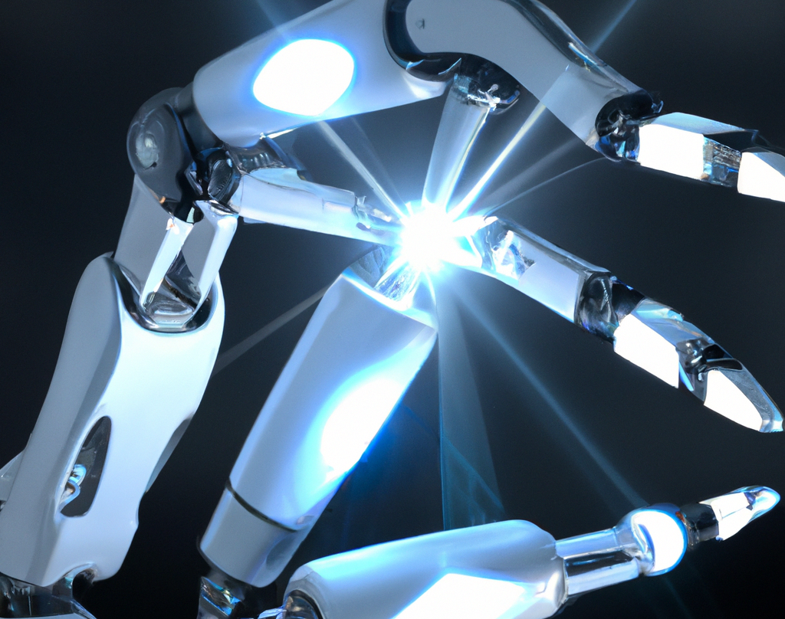
History of AI
The concept of AI has been around since the 1950s. Initially, AI was used to solve mathematical problems and play simple games. Over time, AI has become increasingly sophisticated, with machines now able to recognize speech, images, and even emotions.
Today, AI is being used in a variety of ways, from helping doctors diagnose diseases to powering autonomous vehicles. As AI continues to evolve, it will become an even bigger part of our lives, from helping us make decisions to powering our everyday devices.

Slide 5
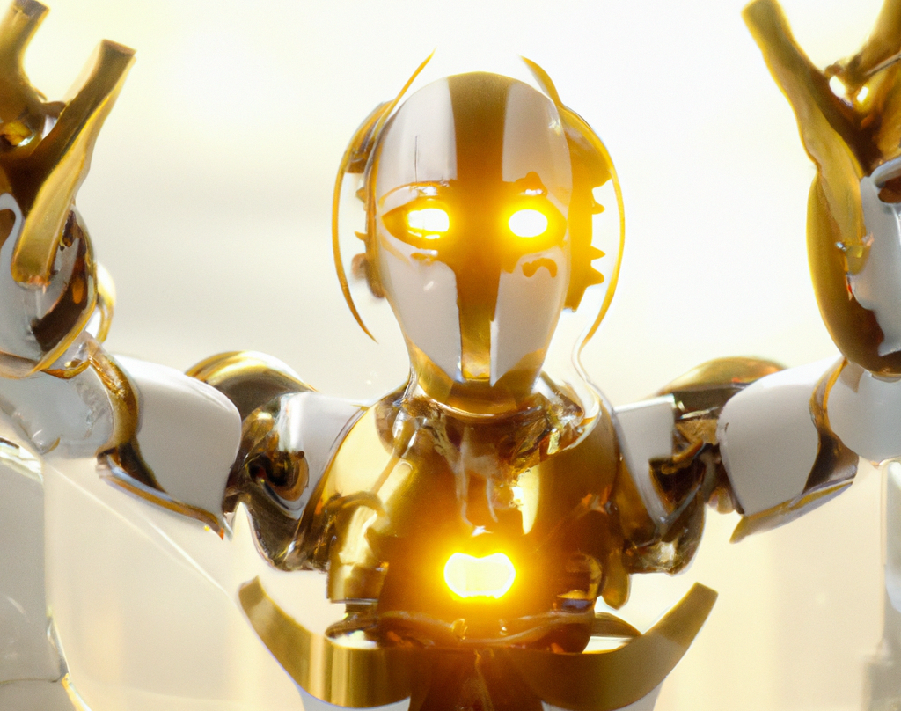
Types of AI
There are three main types of AI: narrow AI, general AI, and super AI.
Narrow AI is used to perform specific tasks, such as facial recognition or language translation.
General AI is used to solve more complex problems, such as playing a game of chess.
Super AI is an advanced form of AI that can think, learn, and adapt like a human. Super AI is still in its early stages of development.

Slide 6
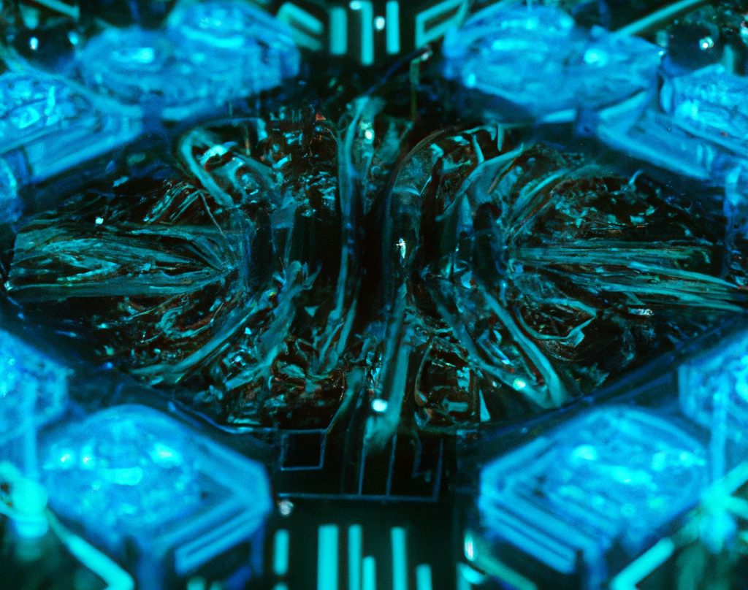
Benefits of AI
AI has the potential to revolutionize the way we live and work. AI can automate tedious tasks, improve decision-making, and enhance customer experiences. AI can also help us make better decisions by providing us with more accurate data and insights.
AI can also help us solve complex problems by providing us with more accurate data and insights. AI can help us make better decisions, automate tedious tasks, and enhance customer experiences. As AI continues to evolve, it will become an even bigger part of our lives.

Slide 7
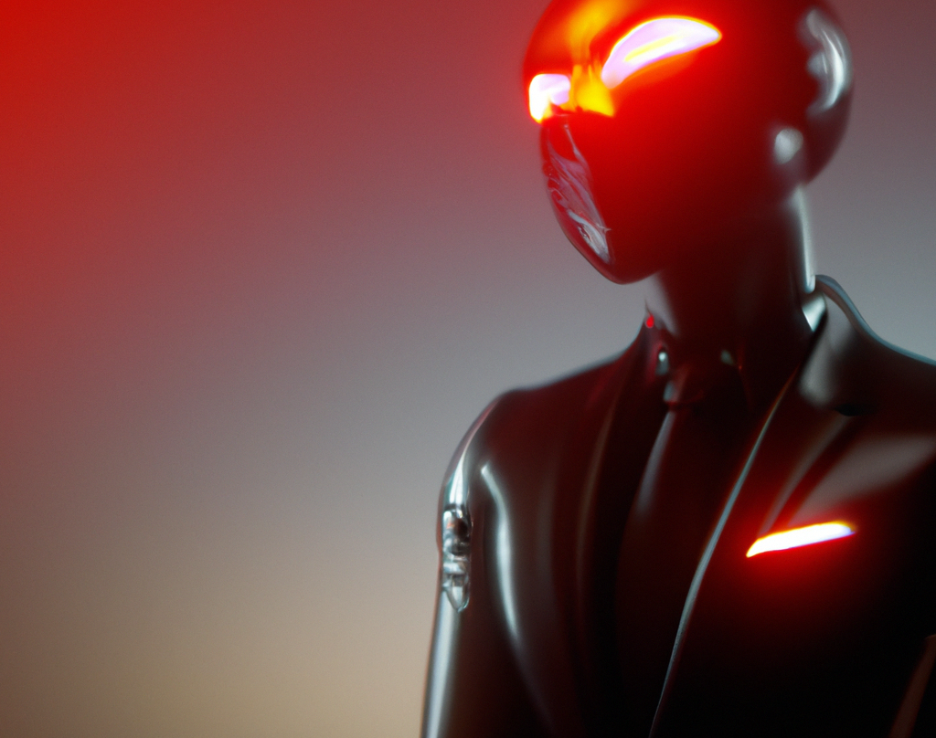
Risks of AI
Although AI has the potential to revolutionize the way we live and work, it also poses some risks. AI can be used for malicious purposes, such as spreading fake news or manipulating stock markets. AI can also lead to job loss, as machines can replace humans in many tasks.
AI can also lead to ethical issues, as machines can be programmed to make decisions that may not be in the best interest of humans. As AI continues to evolve, it is important to consider the potential risks and ethical implications of using AI.

Slide 8
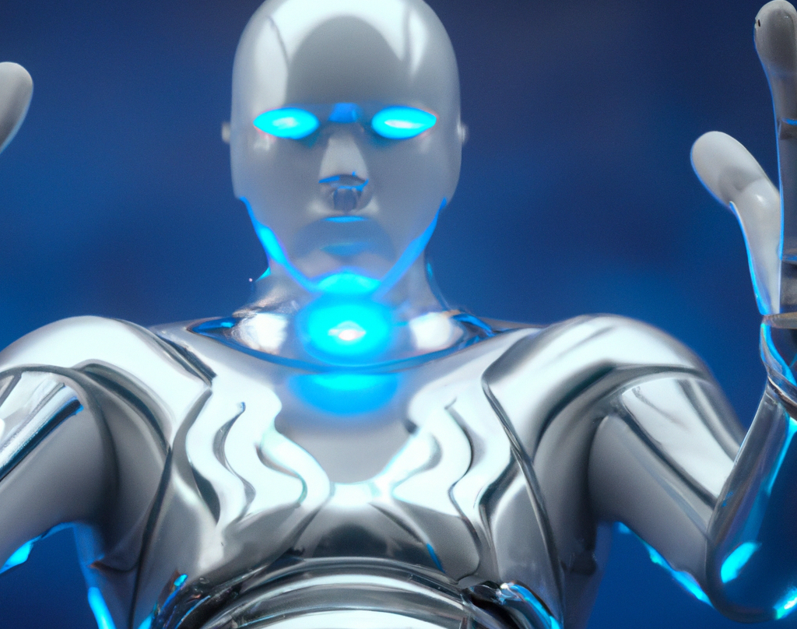
Conclusion
AI has the potential to revolutionize the way we live and work. AI can automate tedious tasks, improve decision-making, and enhance customer experiences. However, it is important to consider the potential risks and ethical implications of using AI.
As AI continues to evolve, it is important to keep up with the latest developments and understand the potential implications of using AI. With careful consideration, AI can be used to make our lives easier and more efficient.

